Slide 1

Online Toll Gate Management System
Project Supervisor: Dr.Mercy Paul Selvan
Name of the Student: Garrepelly Pavan Kumar
Register Number: 39110324

Slide 2

ABSTRACT
Online Toll gate management system is designed to automatically keep track of the vehicle’s movement, record the time and the details like Owner’s name, date of registration, vehicle model etc. This system is very useful for automatic vehicle tracking, time management and also for automation of Toll gate.
Online Toll Gate Management systems have been of great assistance in lessening the over congestion that has become a part of the metropolitan cities these days. It is one of the uncomplicated ways to manage the great run of traffic.

Slide 3

Course Certificate

Slide 4
EXISTING SYSTEM
There are two ways of collecting toll tax being in practice at present. First is the traditional manual method where one person collects the money and issues a receipt. The other one is Smart Card system where the person needs to show the smart card to the system installed at the toll tax depot to open the barrier.

Slide 5

DISADVANTAGES OF EXISTING SYSTEM
In this system each schedule can be tracked from the start till the end of the Project cycle.
User friendliness is provided in the application with various controls.
The system makes the overall project management much easier and flexible.
Readily uploads the latest updates and allows users to interact.

Slide 6

PROPOSED SYSTEM
This system is developed by using Java as front end and MYSQL as back end respectively. The entire process is changed to systematically to avoid access and storage delay. JSP is a good user interface. The proposed system is designed to be more efficient than the manual system. It invokes all base tasks that are now carried out manually, such as the forms transactions and reports which is added advantage

Slide 7
ADVANTAGES OF PROPOSED SYSTEM
Gives accurate information
Simplifies the manual work
It minimizes the documentation related work
Provides up to date information
Friendly environment by providing warning messages.

Slide 8
HARDWARE REQUIREMENTS
System : Pentium Dual Core.
Hard Disk : 120 GB.
Monitor : 15’’ LED
Input Devices : Keyboard, Mouse
Ram : 1 GB

Slide 9
SOFTWARE REQUIREMENTS
Operating system : Windows 11.
Coding Language : JAVA/J2EE
Tool : Netbeans 7.2.1
Database : MYSQL
Github link: https://github.com/pavankumar1681/Onlinetollgate-management-system.git

Slide 10
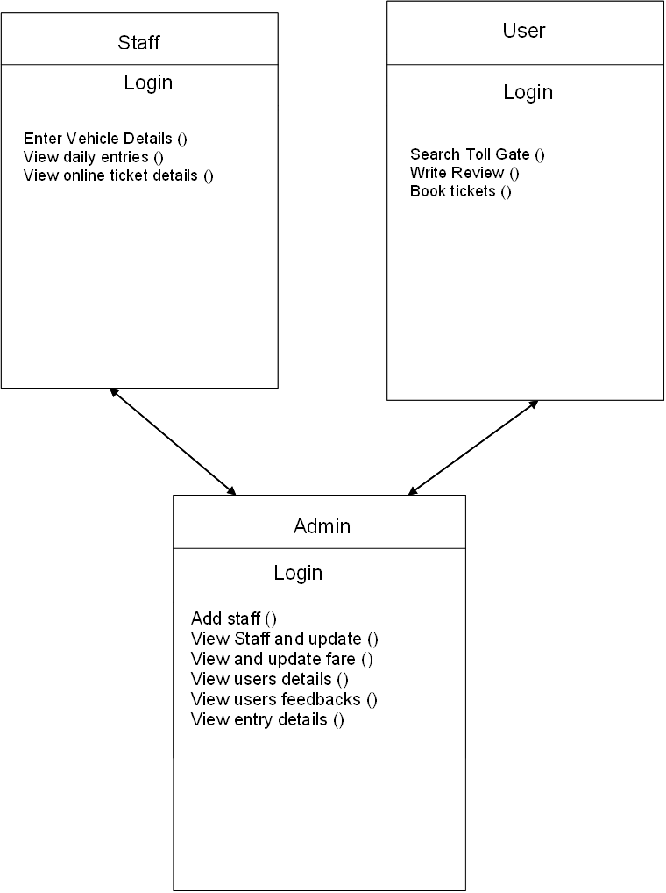
Flow Diagrams

Slide 11
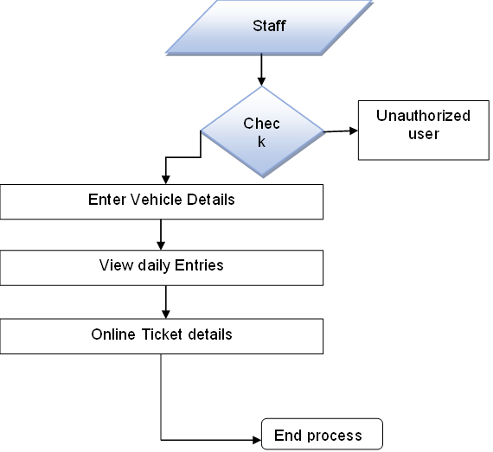
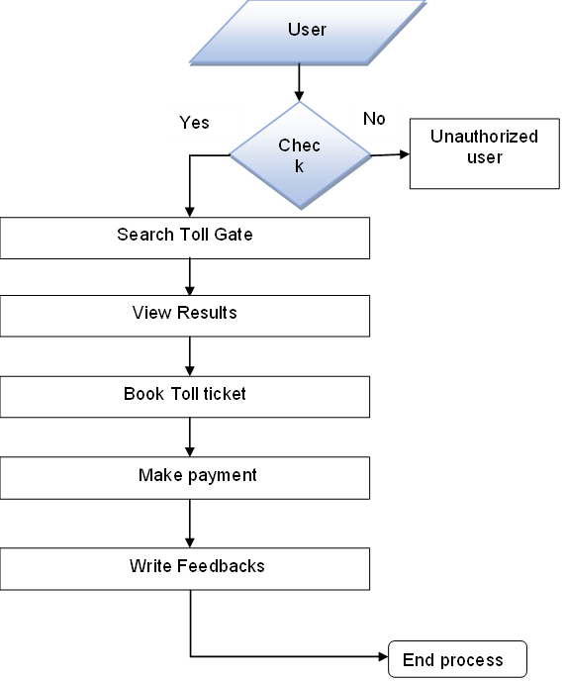
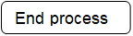
.
Admin:
Admin
User:
Staff:
Check
Unauthorized user
Update Profile
View Toll details
View Toll Entries
View Toll Feedbacks
Fare Details and Update
Add Staff
View Staff details & update
View Users details

Slide 12
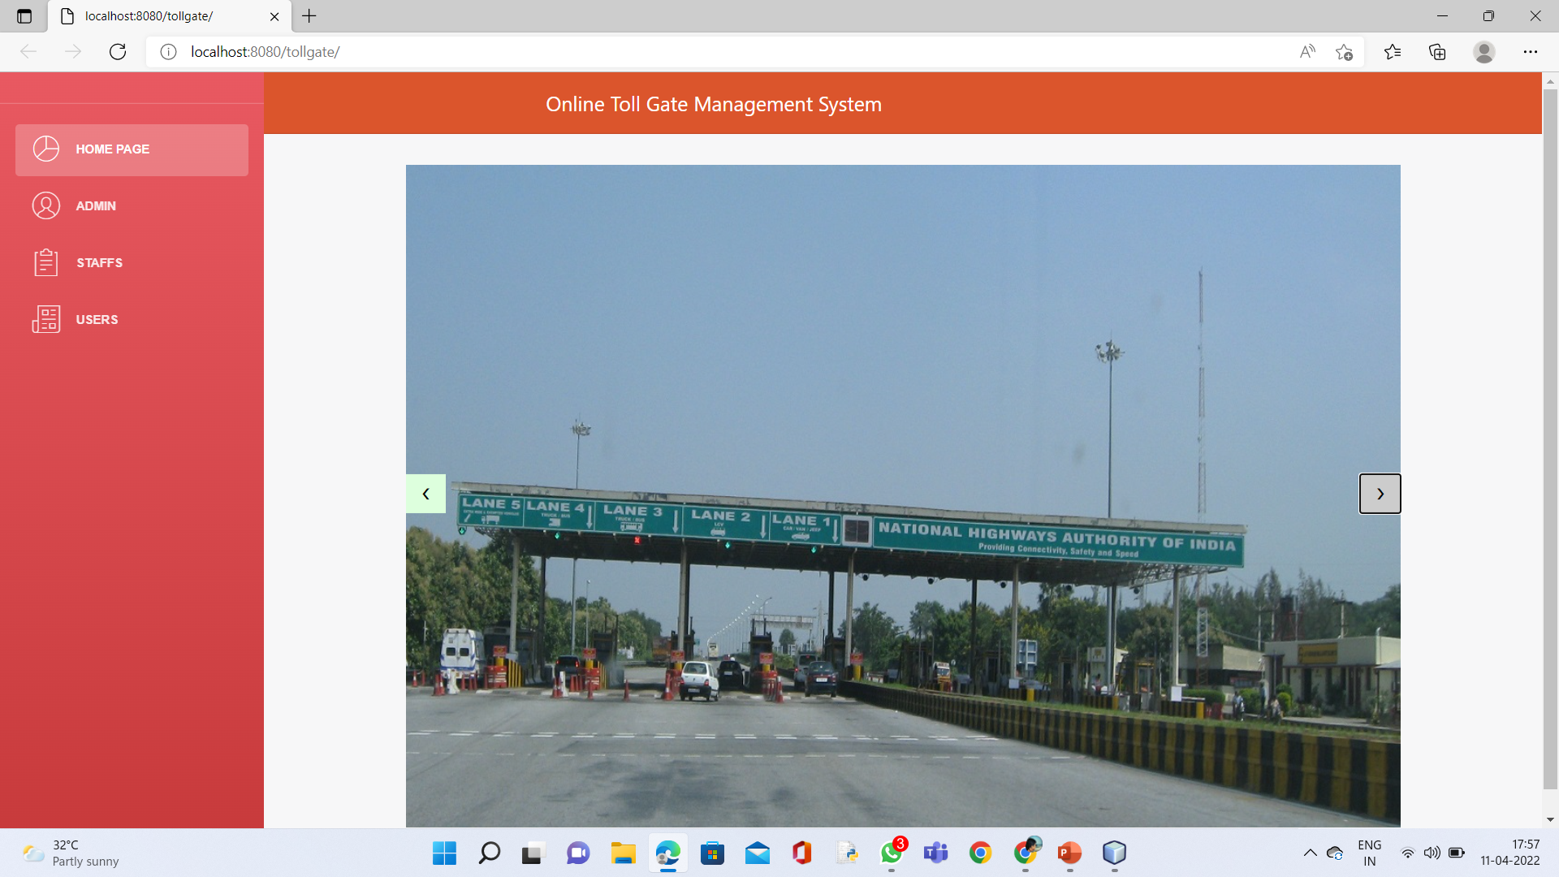
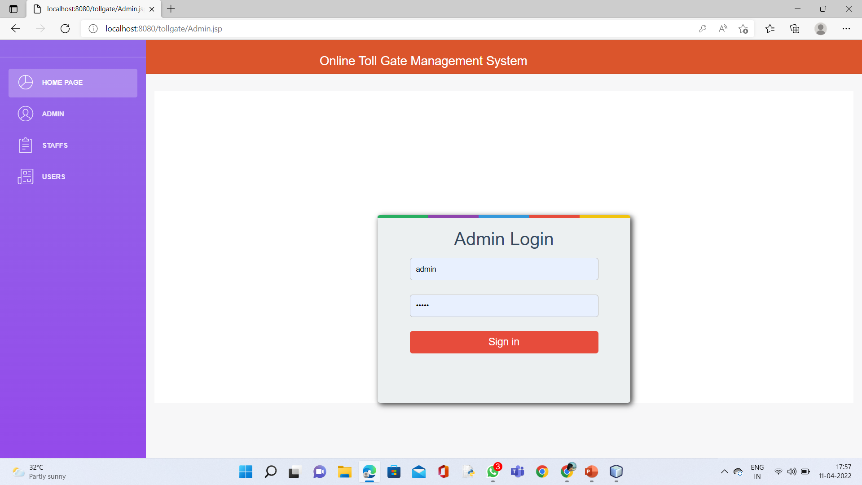
Home Page: Admin Login Page:

Slide 13
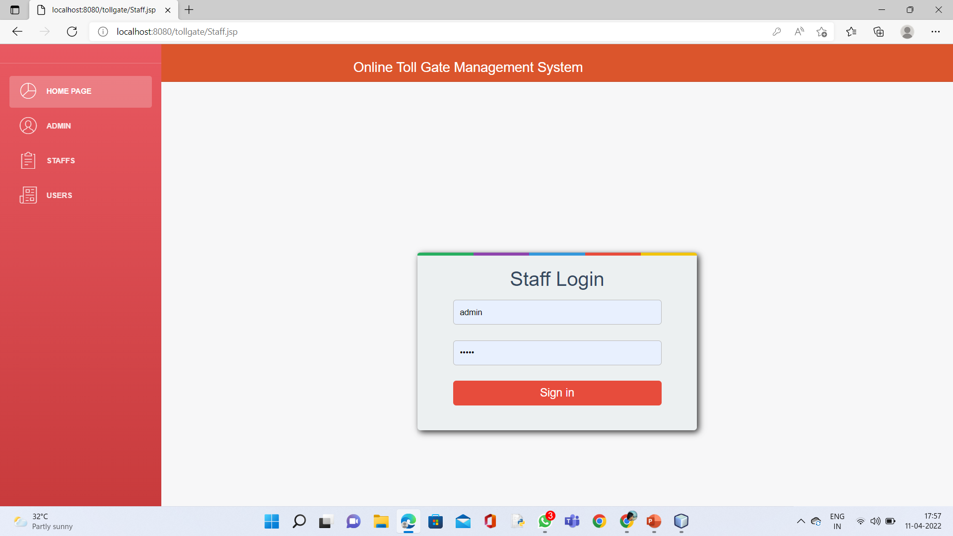

Staff Login Page: User Login Page:

Slide 14
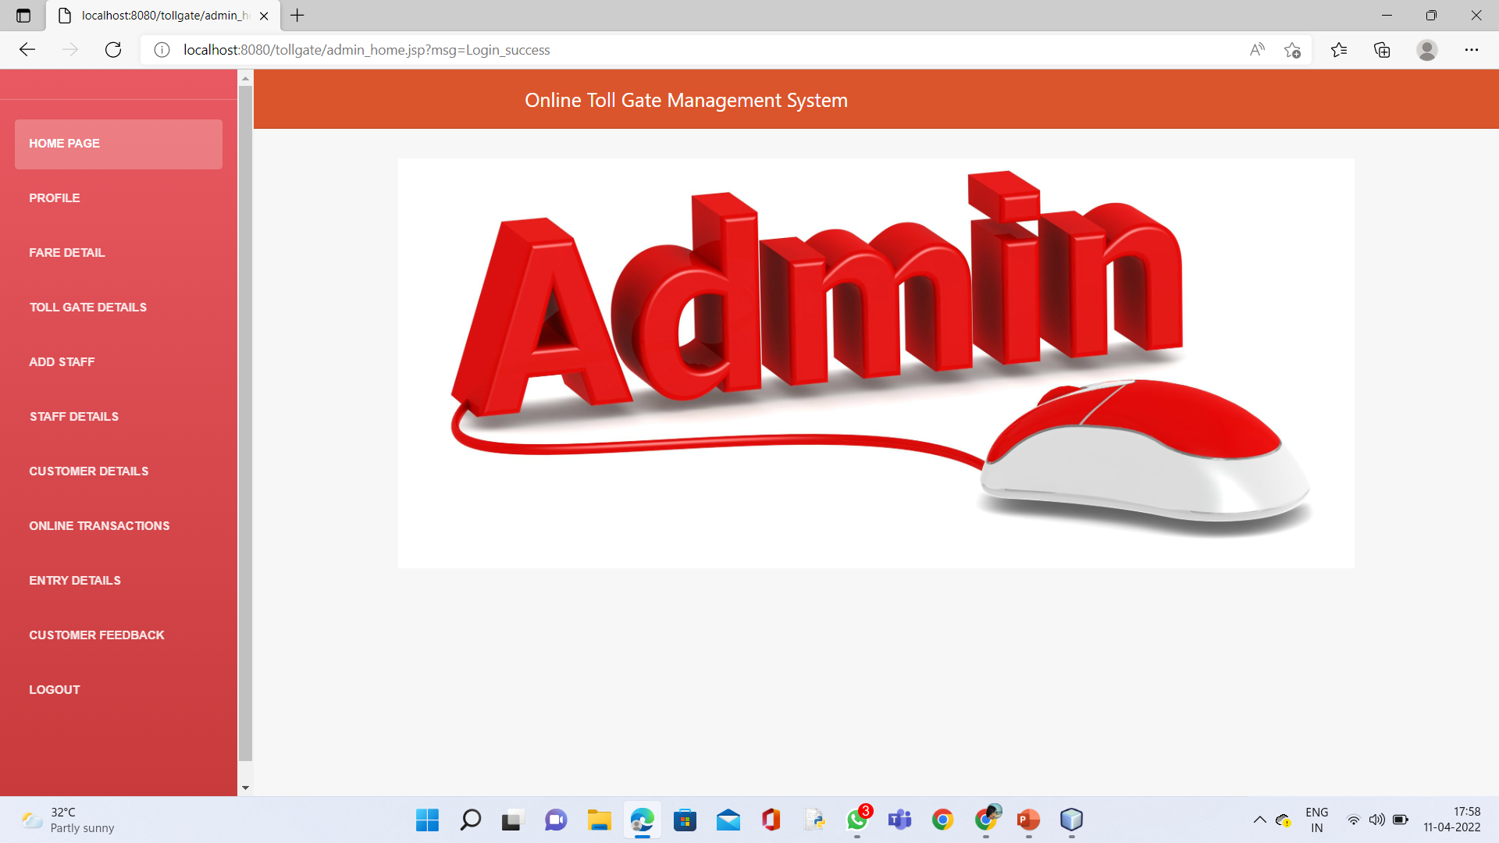
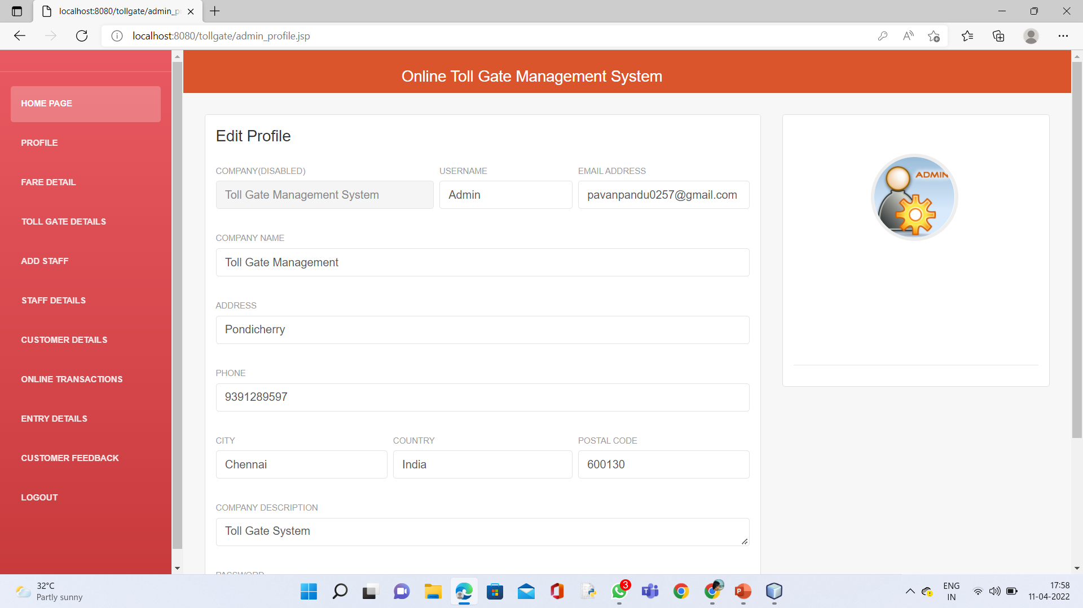
Admin Home Page: Admin Profile Edit Page:

Slide 15
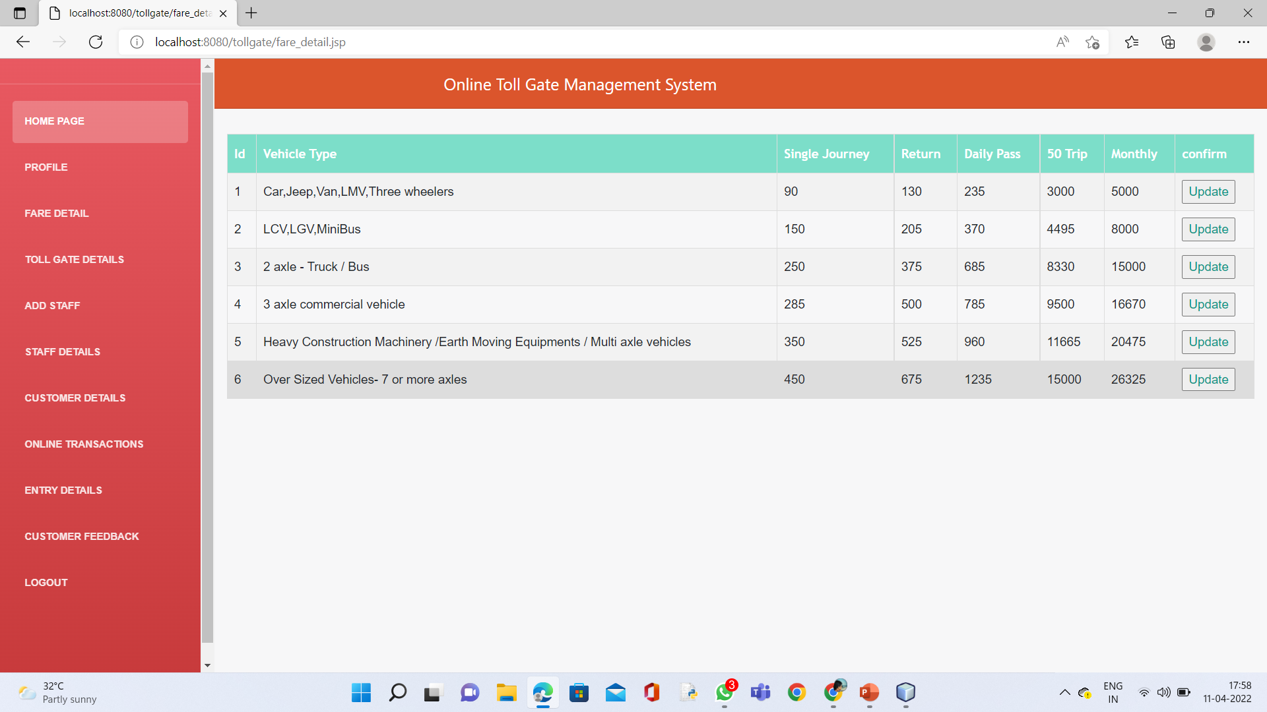
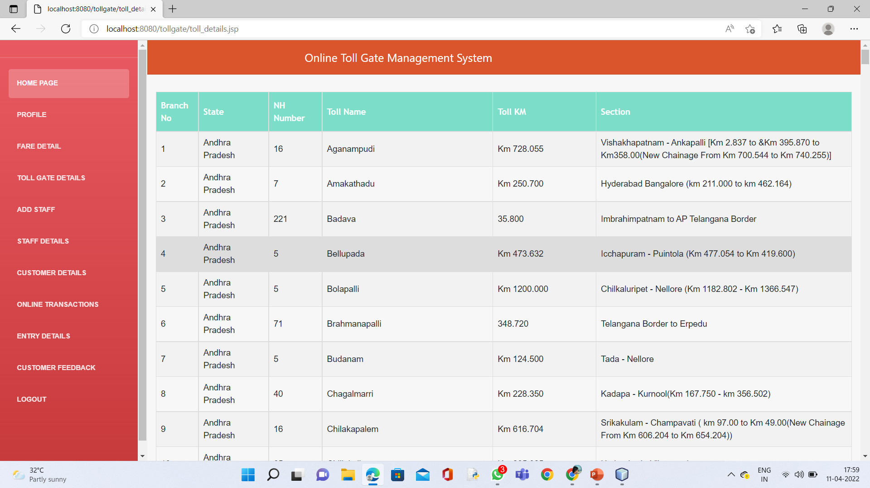
Fare Details Page: Toll Gate Details :

Slide 16
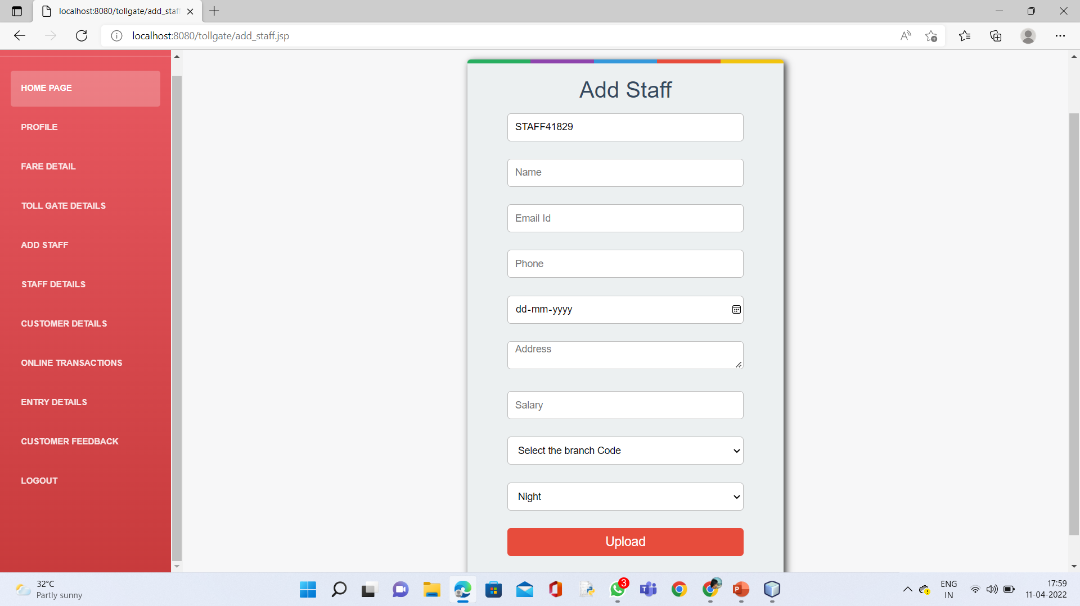
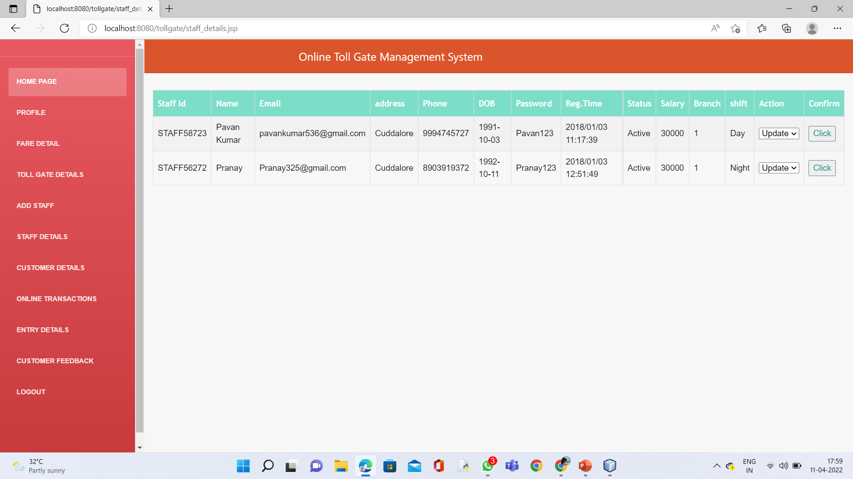
Add Staff : Staff Details:

Slide 17
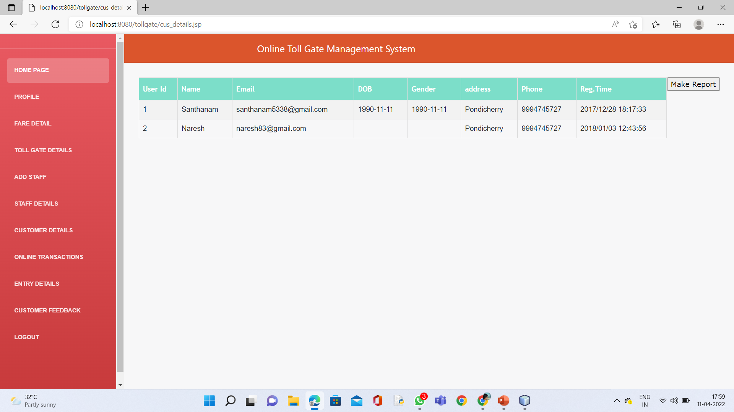
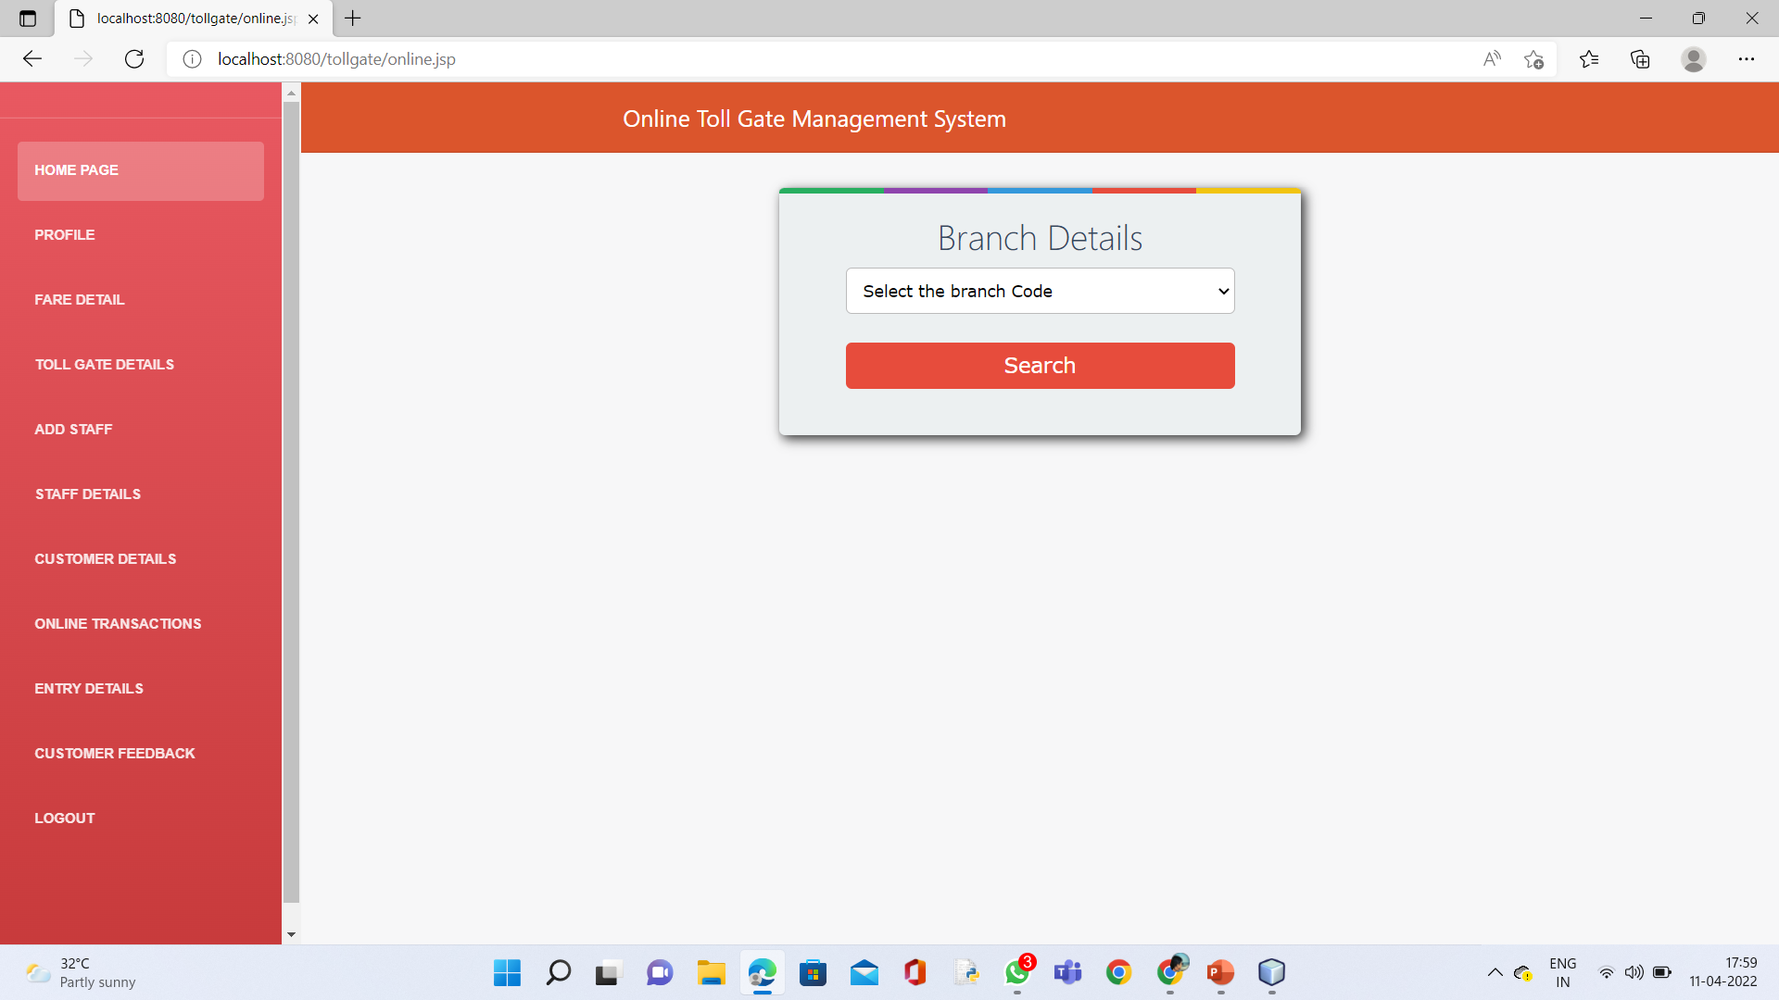
Customer Details: Online Transations:

Slide 18
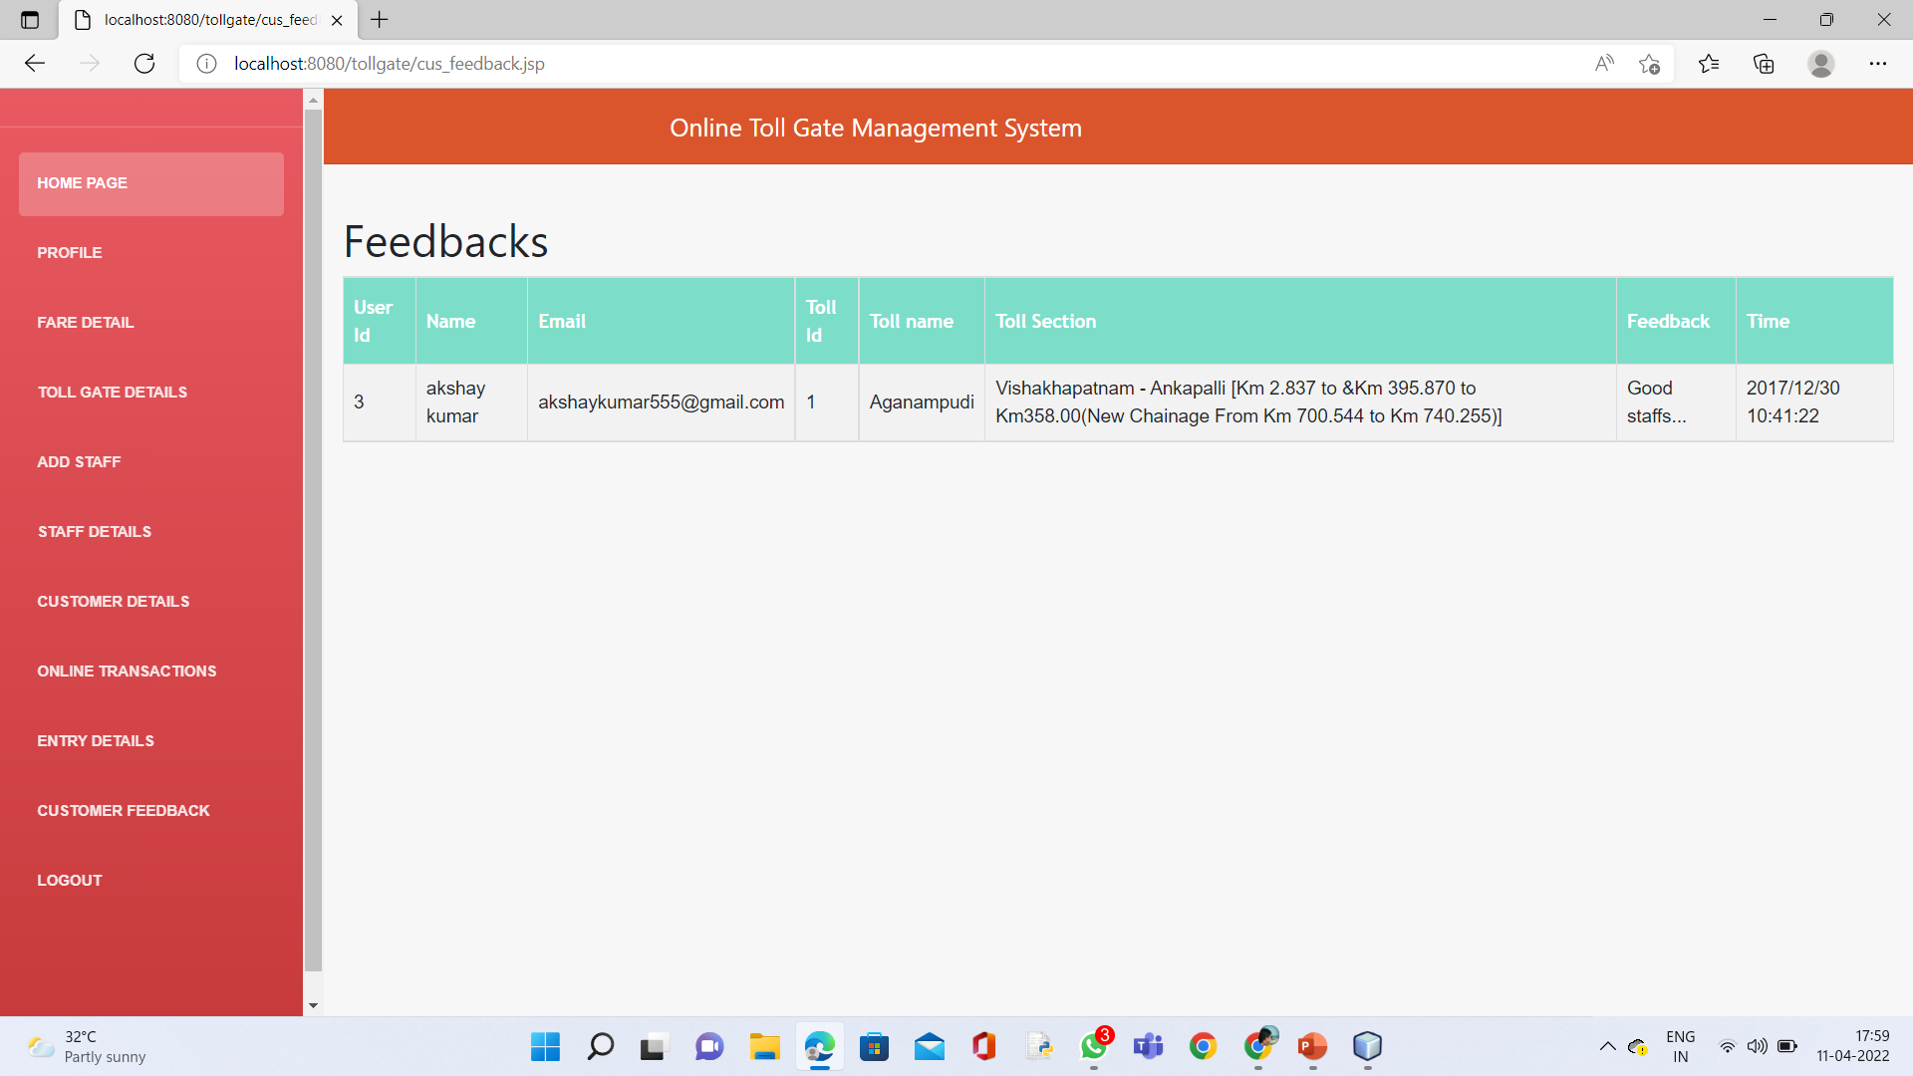
Entry Details: Customer Feedback:

Slide 19
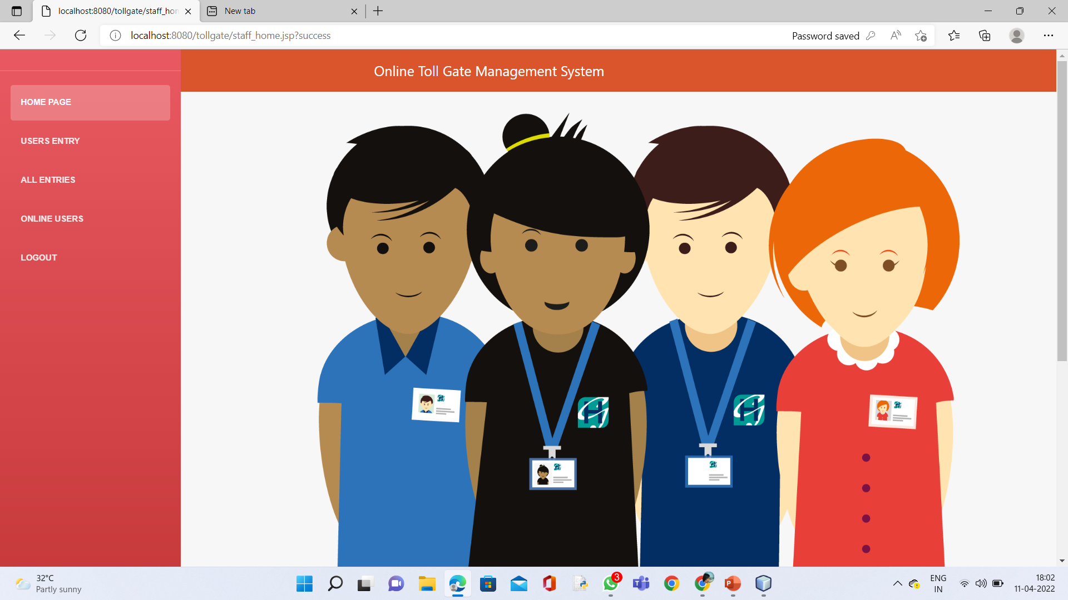
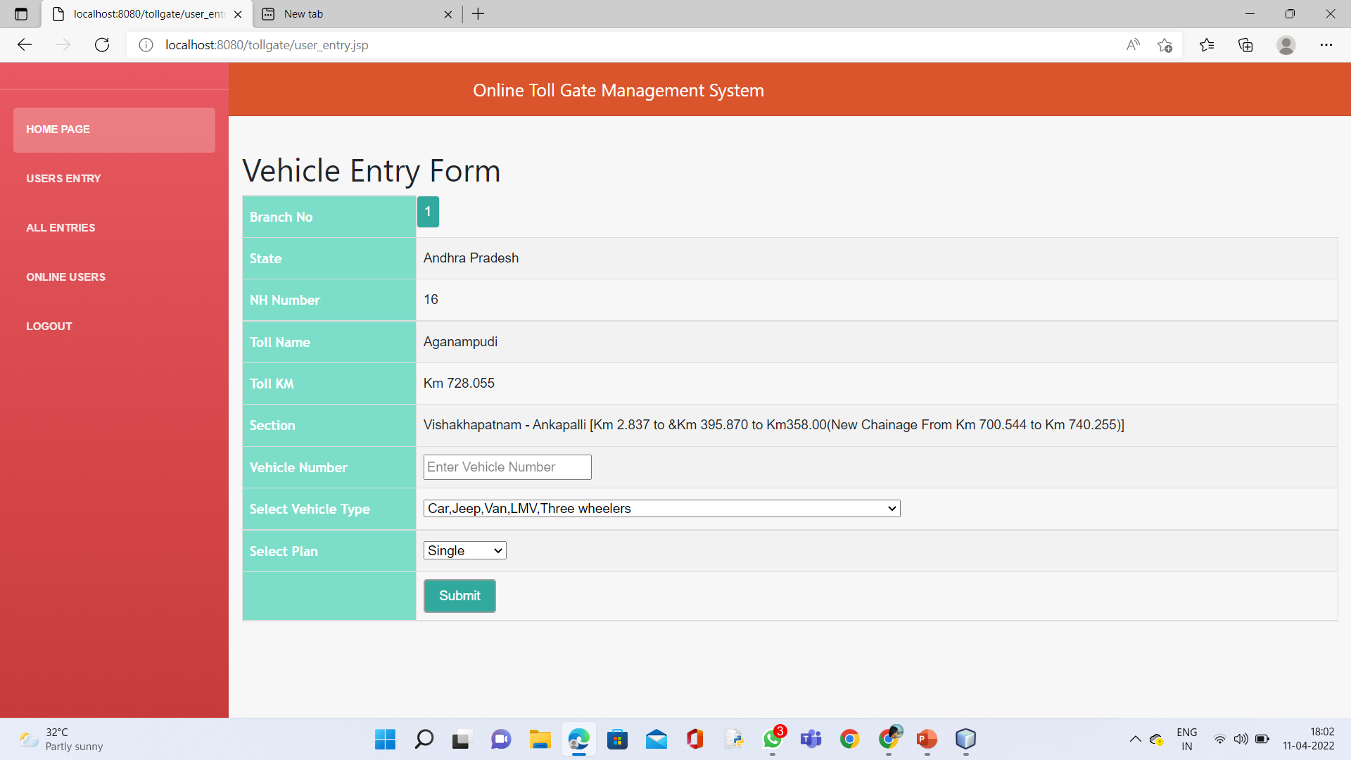
Staff Home Page: Users Entry:

Slide 20
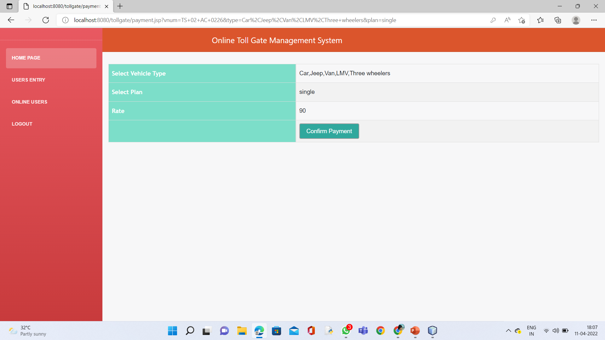
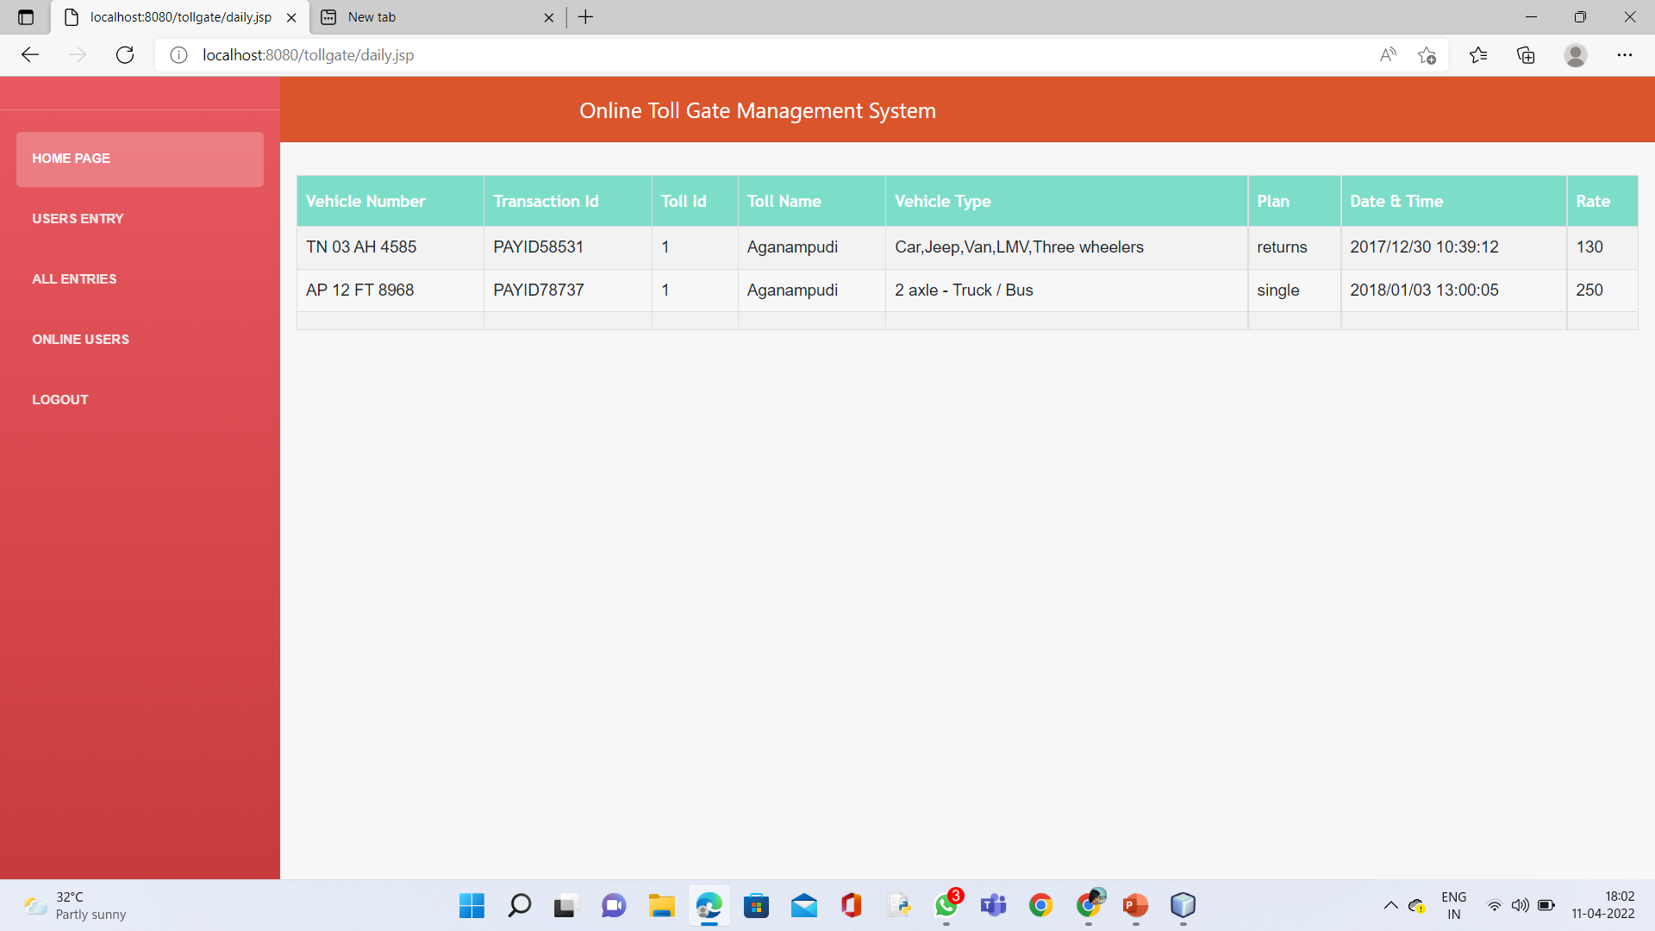
Staff Payment Page: All ENTRIES:

Slide 21
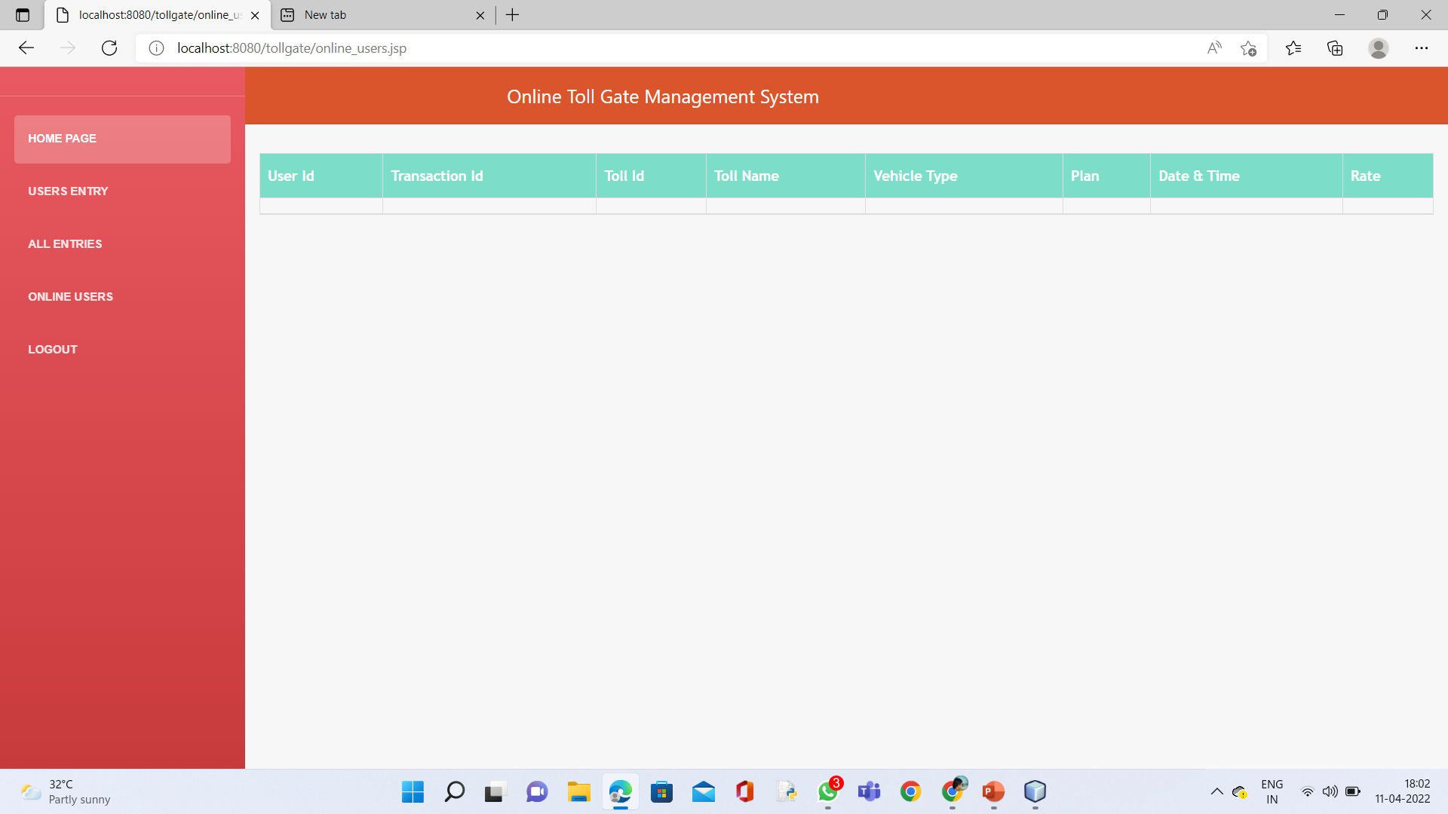
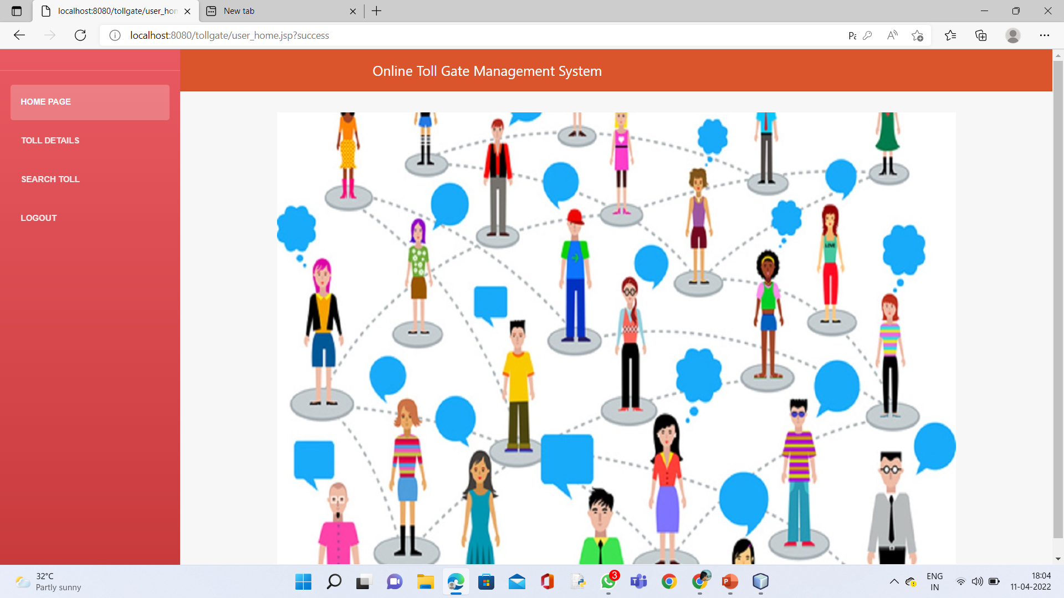
Online Users: Users Home page:

Slide 22
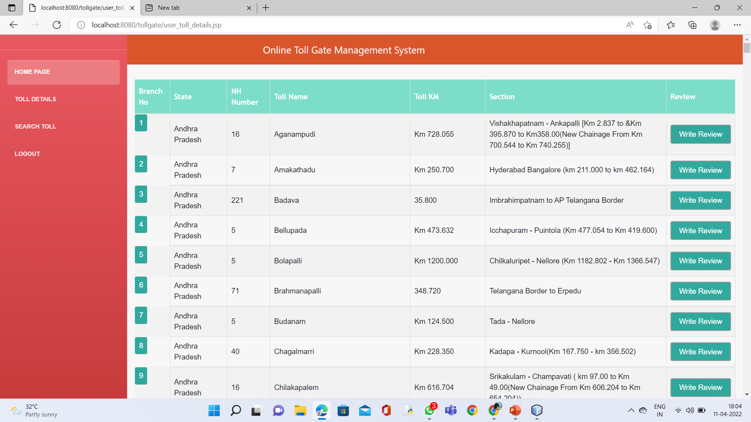
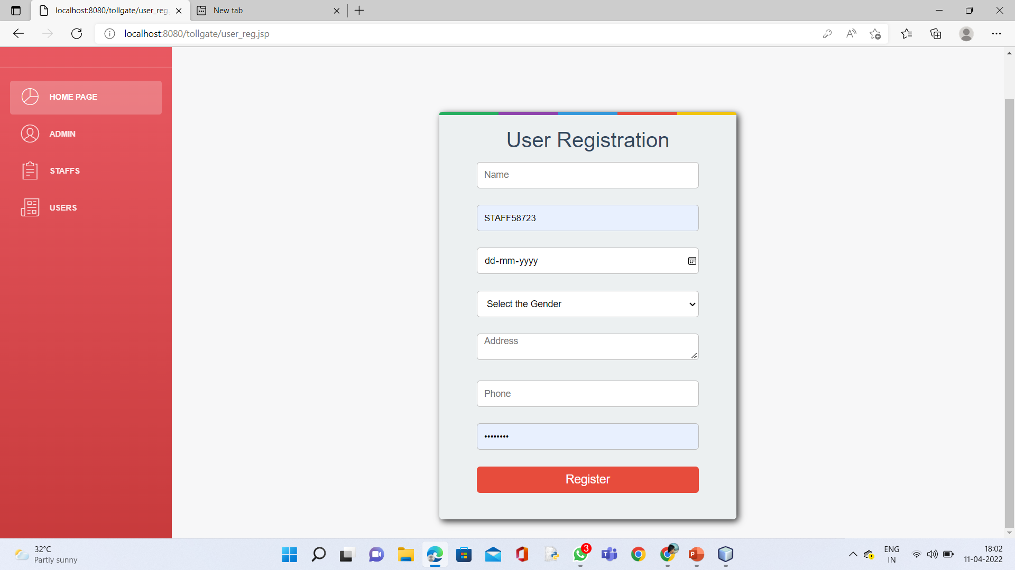
Registration Page: Toll Details:

Slide 23
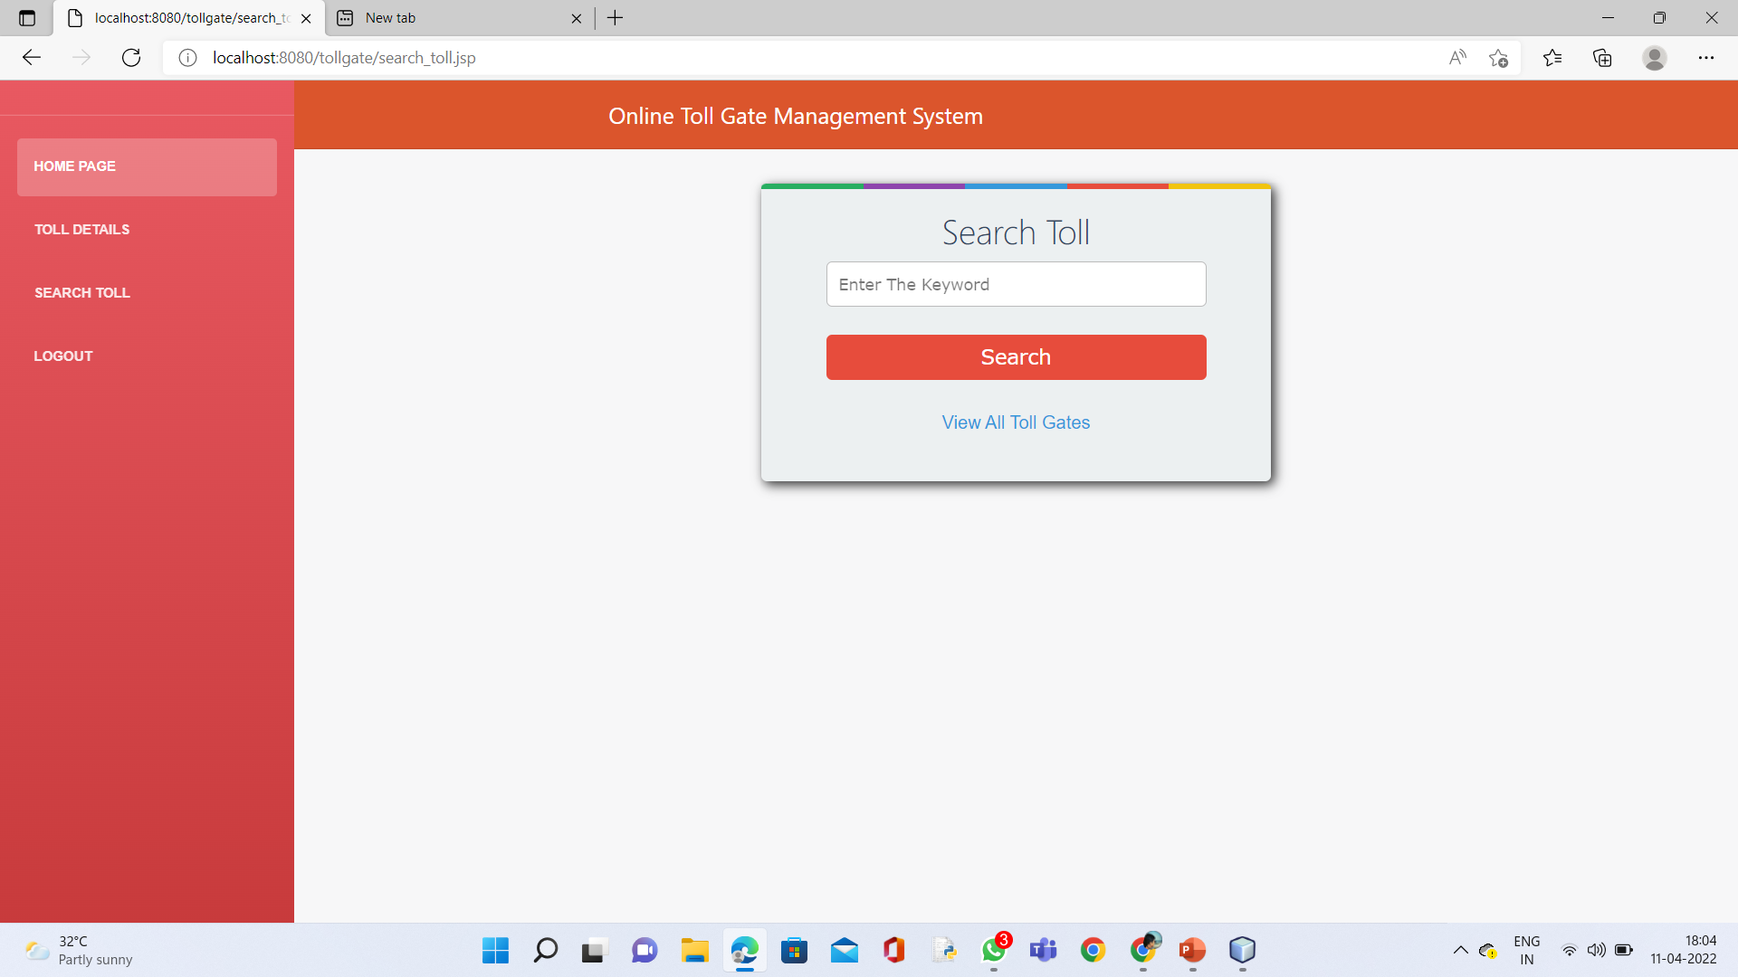
Search Details: Search Toll:

Slide 24

User Payment Page:

Slide 25


